Slide 1
OFFICE SUPPLY
(Q3_2013)-(Q4_2014)

Slide 2
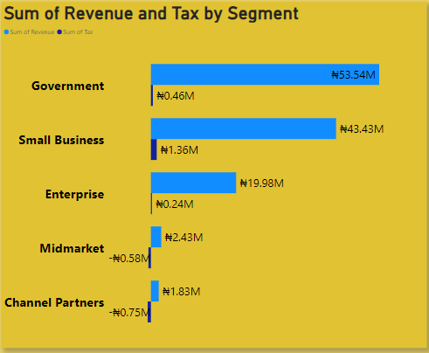
Sum of Revenue and Tax by Segment
Total revenue across office supply segments is $121.22 million. The government sector leads with $53.54 million in revenue and $0.40 million in taxes. Small businesses follow with $43.43 million in revenue and the highest tax at $1.36 million. Enterprises generate $19.98 million in revenue and $0.24 million in taxes. The mid-market segment has $2.23 million in revenue and a tax deduction of $0.58 million. Channel partners report the lowest revenue of $1.83 million and a negative tax of -$0.75 million.
It is recommended to Focus on improving revenue and tax contributions in the mid-market and channel partner segments. Leverage the strong revenue from the government sector to scale operations and enhance tax strategies. Target efforts to boost profitability and tax efficiency in underperforming segments.

Slide 3
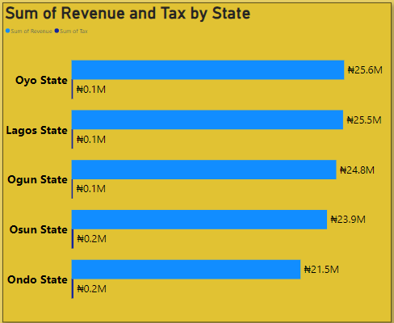
Sum of Revenue and Tax by State
Office supply distribution spans five states. Oyo State leads with the highest revenue of $25.6 million and a tax contribution of $0.1 million. Lagos State follows closely with $25.5 million in revenue and $0.1 million in taxes. Ogun State generates $24.8 million in revenue, with a tax of $0.1 million. Osun State reports $23.9 million in revenue and the highest tax of $0.2 million. Ondo State has the lowest revenue at $12.5 million but ranks second for tax contribution, also at $0.2 million.
To optimize performance, consider strategies to increase revenue in lower-performing states like Ondo. Maintain and enhance revenue generation in leading states such as Oyo and Lagos while focusing on improving tax efficiency. Additionally, explore ways to balance revenue and tax contributions more evenly across all states to ensure sustained growth and financial stability.

Slide 4
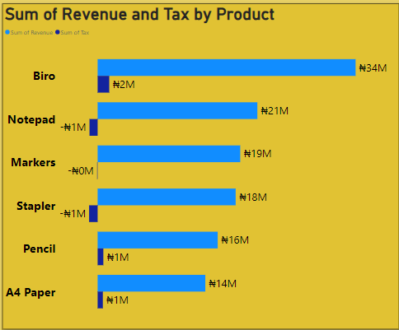
Sum of Revenue and Tax by Product
Office supply offers six products. Biro leads with the highest revenue of $34 million and the highest tax collected at $2 million. Notepad follows with $21 million in revenue but has a tax deduction of -$1 million. Markers generate $19 million in revenue with no tax collected. Stapler earns $18 million in revenue and has a tax deduction of -$1 million. Pencil reports $16 million in revenue with $1 million in tax collected. A4 paper achieves $14 million in revenue and $1 million in tax.
It is recommended to Focus on leveraging Biro’s strong performance and high tax contribution to drive overall profitability. Address negative tax contributions for Notepad, Markers, and Stapler by reassessing pricing strategies and cost structures. Enhance revenue and tax efficiency for Pencil and A4 paper to maximize their financial impact. Implement strategies to balance the product portfolio for more consistent revenue and tax performance across all items.

Slide 5
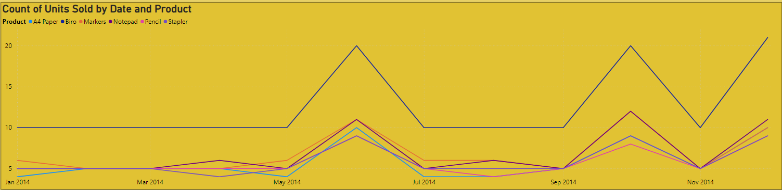
Count of Units Sold by Date and Product
In 2014, the highest unit sales occurred in June, October, and December. A4 paper led with the highest units sold throughout the year, while sales in other months were comparatively lower.
It is recommended to Capitalize on the strong sales periods in June, October, and December by implementing targeted promotions or stock increases during these months. Analyze the factors contributing to A4 paper's high sales to apply similar strategies to other products. Investigate and address the reasons behind lower sales in other months to create more consistent revenue throughout the year.

Slide 6
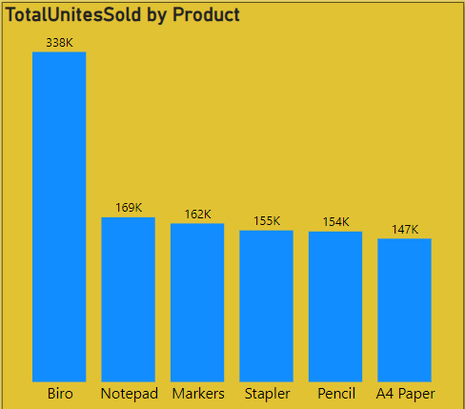
Total Unites Sold by Product
From Q3 2013 to Q4 2014, Biro had the highest unit sales with 338,000 units sold, followed by Notepad with 168,000 units, Markers with 162,000 units, Stapler with 155,000 units, and Pencil with 154,000 units. A4 Paper had the lowest sales during this period with 147,000 units.
Leverage Biro's strong sales performance to further promote this product and explore opportunities to replicate its success for Notepad, Markers, Stapler, and Pencil. Develop strategies to boost A4 Paper sales, such as targeted marketing campaigns or promotional offers, to increase its market share and overall performance. Analyzing the sales trends and customer preferences during this period can provide insights for optimizing product strategies and inventory management.

Slide 7
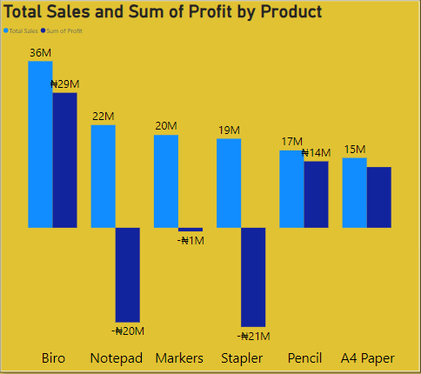
Total Sales and Sum of Profit by Product
By product, Biro leads with the highest sales of $36 million and a profit of $29 million. Notepad follows with $22 million in sales but has the second-lowest profit at -$20 million. Markers generate $20 million in sales and have the third-lowest profit at -$1 million. Stapler achieves $19 million in sales but has the lowest profit at -$21 million. Pencil reports $17 million in sales and a profit of $14 million. A4 Paper earns $15 million in sales and a profit of $12 million.
Focus on enhancing Biro’s profitability by maintaining its strong sales performance and exploring ways to optimize costs. Address the negative profit margins for Notepad, Markers, and Stapler by revisiting pricing strategies and cost management. Investigate and implement measures to improve profitability for these products. Leverage the positive profit performance of Pencil and A4 Paper by scaling their production and sales efforts to further boost overall profitability.

Slide 8
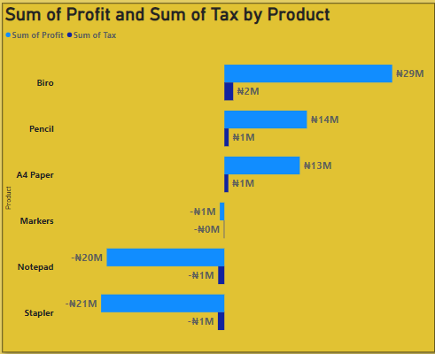
Sum of profit and sum of tax by product
By product, Biro achieves the highest profit of $29 million and $2 million in tax collected. Pencil follows with $14 million in profit and $1 million in tax collected. A4 Paper has a profit of $13 million and $1 million in tax collected. Markers report a low profit of -$1 million with no tax collected. Notepad shows a significant loss with -$20 million in profit and -$1 million in tax. Stapler has the lowest profit of -$21 million and also a tax of -$1 million.
Continue to leverage Biro’s strong profit and tax contributions to support overall financial health. For Pencil and A4 Paper, consider strategies to further enhance their profitability and optimize their tax contributions. Address the negative profit and tax issues for Markers, Notepad, and Stapler by analyzing and improving cost structures, pricing strategies, and operational efficiencies. Implement corrective actions to reduce losses and turn these products towards positive profit and tax outcomes.

Slide 9
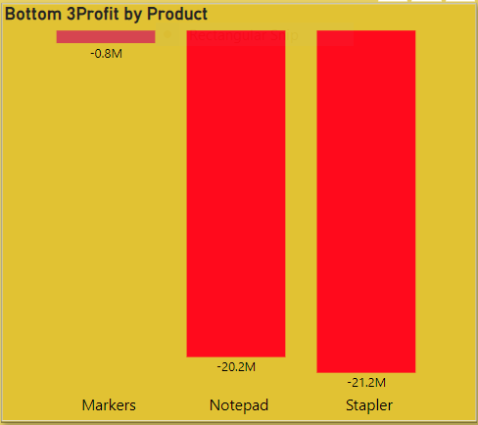
Bottom 3 Profit by Product
To enhance overall profitability, it is advisable to discontinue the three least profitable products. The markers, with a loss of $0.8 million, should be prioritized for removal, followed by the notepads, which have a loss of $20.2 million. Lastly, the staplers, showing the highest loss of $21.2 million, should also be discontinued.

Slide 10
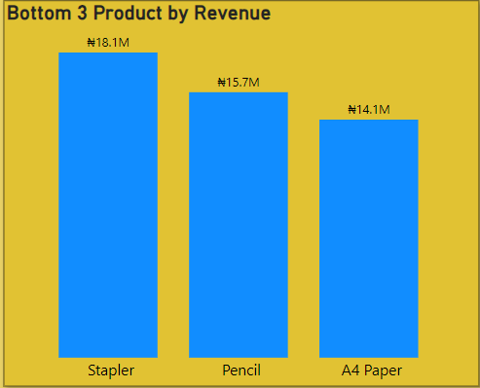
Bottom 3 Product by Revenue
In assessing the potential discontinuation of low-performing products based on revenue, it is advisable to consider removing the following items from the product lineup due to their suboptimal financial performance: Stapler, with revenue of $18.1 million; Pencil, with $15.7 million in revenue; and A4 Paper, generating $14.1 million.

Slide 11
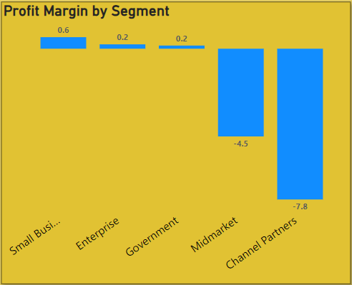
Profit Margin by Segment
Analyzing profit margins by segment reveals that the Small Business segment achieves the highest profit margin at 0.6, followed by the Enterprise and Government segments, both with a profit margin of 0.2. Conversely, Channel Partners exhibit the lowest profit margin at -7.8, with the Mid-Market segment also showing a negative profit margin of -4.5.
To enhance overall profitability, it is recommended to focus on strategies that improve profit margins in the Channel Partners and Mid-Market segments. Given their negative margins, targeted interventions to reduce costs or increase revenue in these areas could help in balancing the financial performance across all segments. Meanwhile, leveraging the higher margins in the Small Business segment could provide insights and strategies that might be applied to the less profitable segments.

Slide 12
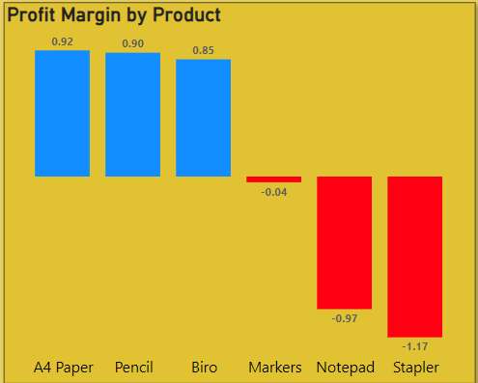
Profit Margin by Product
An analysis of profit margins by product indicates that A4 Paper leads with the highest profit margin of 0.92, followed closely by Pencil at 0.90 and Biro at 0.85. In contrast, Stapler reports the lowest profit margin at -1.17, followed by Notepad with -0.97, and Markers with a marginally negative margin of -0.04.
To optimize profitability, it is recommended to prioritize the enhancement of strategies for the Stapler and Notepad products, given their significantly negative profit margins. Investigate potential cost reduction or pricing adjustments for these items. Additionally, leverage the strong performance of A4 Paper, Pencil, and Biro to further capitalize on their positive margins and explore opportunities to replicate their success across other product lines.

Slide 13
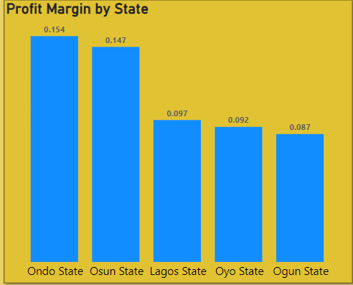
Profit Margin by State
Profit margin analysis by state reveals that Ondo State achieves the highest profit margin at 0.154, followed by Osun State with a margin of 0.147. Lagos State ranks next with a margin of 0.097, while Oyo State shows a margin of 0.092. Ogun State has the lowest profit margin at 0.087.
To enhance overall profitability, it is recommended to focus on strategies that improve performance in Ogun State, which has the lowest profit margin. Consider implementing targeted initiatives to boost profitability in this region. Additionally, analyze the successful practices in Ondo and Osun States to identify potential strategies that could be adapted to improve margins in lower-performing states.

Slide 14
THANK YOU

